Slide 1
Case Study: Cyclistic bike-share
By Maximillian Johnson

Slide 2
Case Study Background
Cyclistic is a rent-a-bike service based in Chicago,with users being divided into Member and Casual riders. The director of marketing believes that the company’s successes depends of maximizing the amount of Member users. My team is tasked with designing a new marketing strategy to converting casual riders into Members and more specifically I am tasked with answering the question, “How do members and casual riders use Cyclistic bikes differently?”

Slide 3
Difference Between Casual and Member Riders
By Maximillian Johnson

Slide 4
What we already know
Business Task:
Understand the difference between casual and annual members
Customers mostly use Cyclist for leisure
30% of customers use Cyclist for work
Ride options are as follows : single-ride, full day pass , and annual memberships

Slide 5
Data Limitations
There was no record of distance traveled
Both full day passes , and single-day rides were under one category

Slide 6
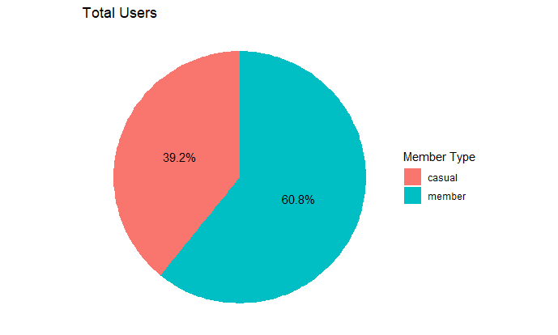
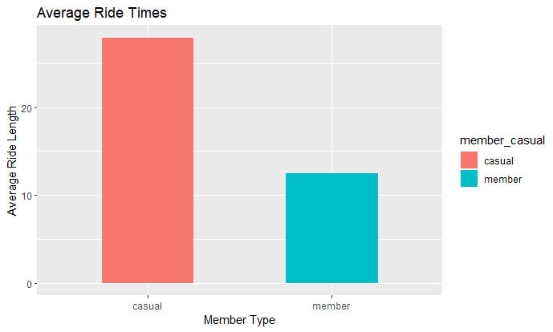
Analysis
These graphs show that a majority of the rides taken within the dataset was done by members, but it looks like causal riders ride for more than double the time that members do.

Slide 7
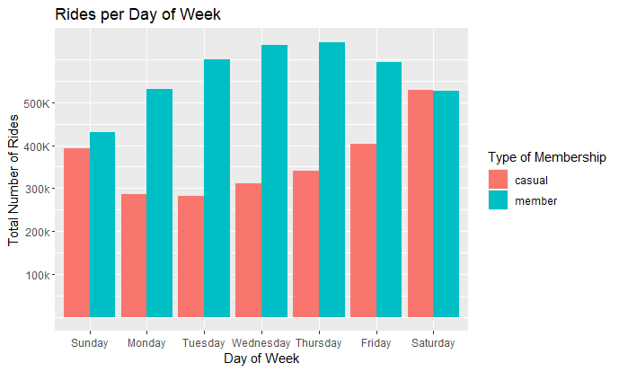
Analysis
This graph shows that member rides peak during the week with the most popular day being on Thursday, while casual rides peak during the weekend with the most popular day being on saturday.

Slide 8
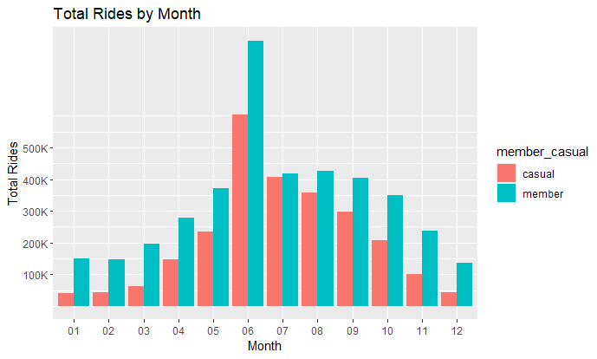
Analysis
This graphs shows to total rides taken by members and casual users throughout the year, both peaking in June. This could possibly be due to warmer weather .
note* Notice how through the year even if there's an obvious rise and fall, member tend to stay more consistent throughout the year.

Slide 9
Takeaways
Members tend to have a higher frequency of rides with a lower average ride time, and casual riders tend to have a lower frequency of rides with longer ride times . Members also use Cyclistic more consistently throughout the seasons. This data points to a couple of conclusions.Members use the service as a utility, , as if they are going to their local grocery store to pick up food.Casual members seem to use the service for leisure or exercise .

